Slide 1
Chapter 12
INTERRUPTS

Slide 2
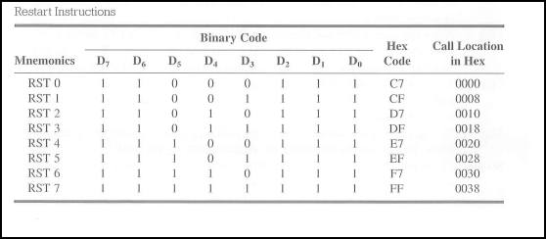

Slide 3
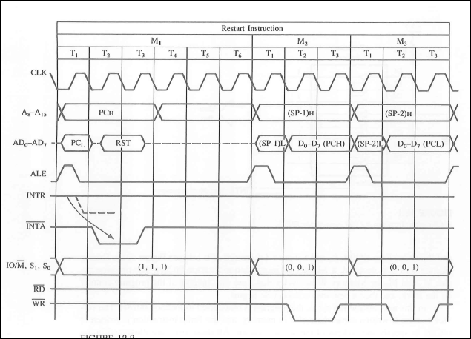

Slide 4


Slide 5
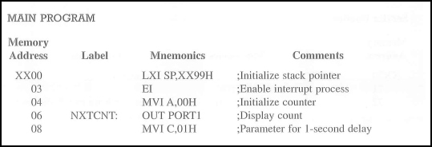


Slide 6
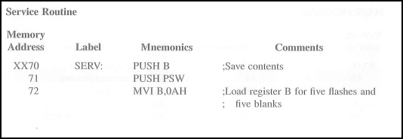
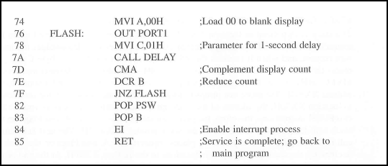

Slide 7


Slide 8
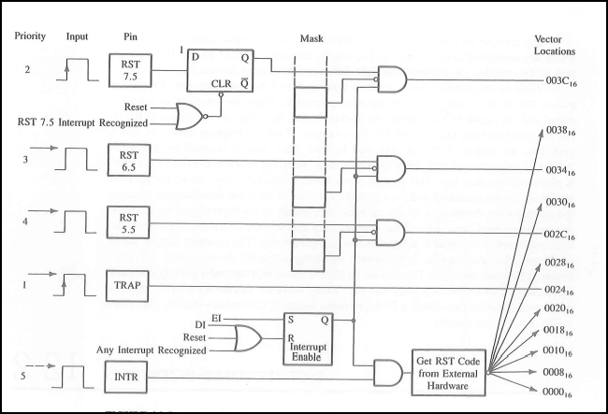

Slide 9
TRAP
Nonmaskable Interrupt (NMI)
Highest Priority Interrupt
It can not be disabled
It cant be acknowledged again unteil it makes transition from high to low to high.
Used in critical cases events like power failure and emergency shut-off.

Slide 10
RST 7.5, 6.5,5.5
EI
SIM (Set Interrupt Mask)
1 Byte instruction
Reads the content of the accumulator and enables or disables the interrupts according to these contents

Slide 11
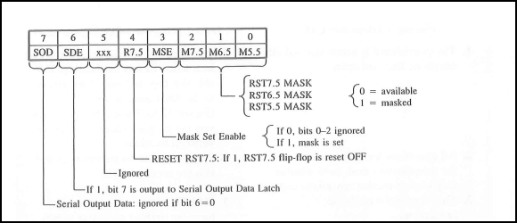
SIM

Slide 12
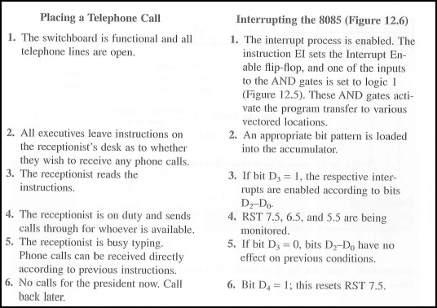

Slide 13
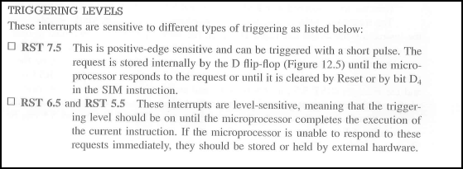
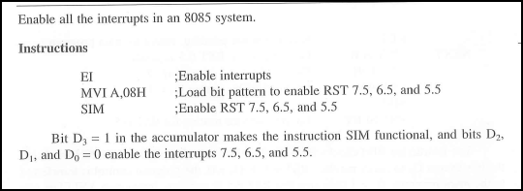

Slide 14
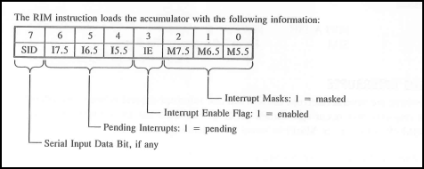
RIM (Read Interrupt Mask)

Slide 15


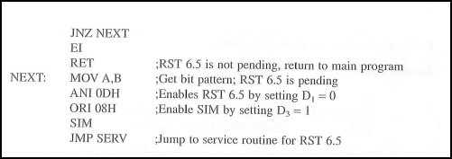

Slide 16

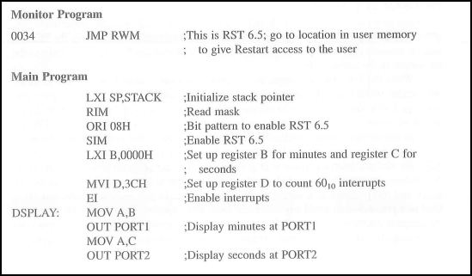


Slide 17
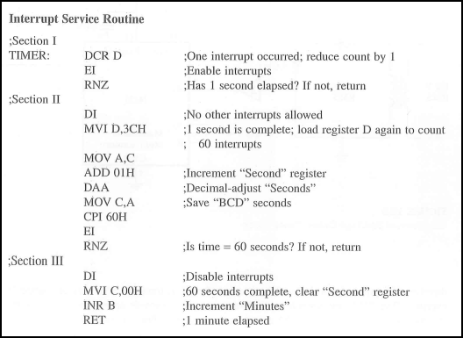

Slide 18
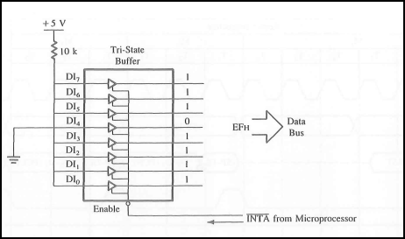

Slide 19
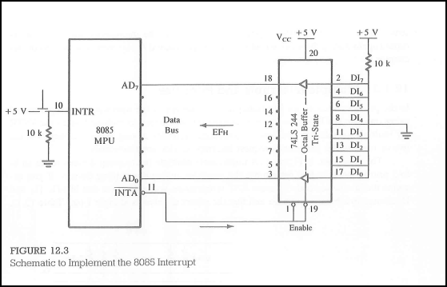

Slide 20
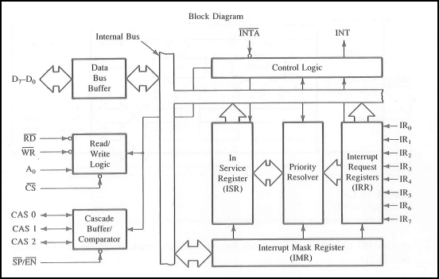

8259 Block Diagram

Slide 21



Slide 22
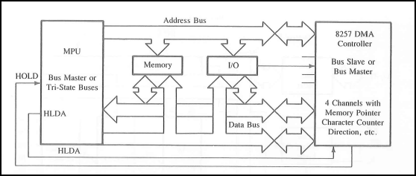
DMA data Transfer

Slide 23
